Slide 1
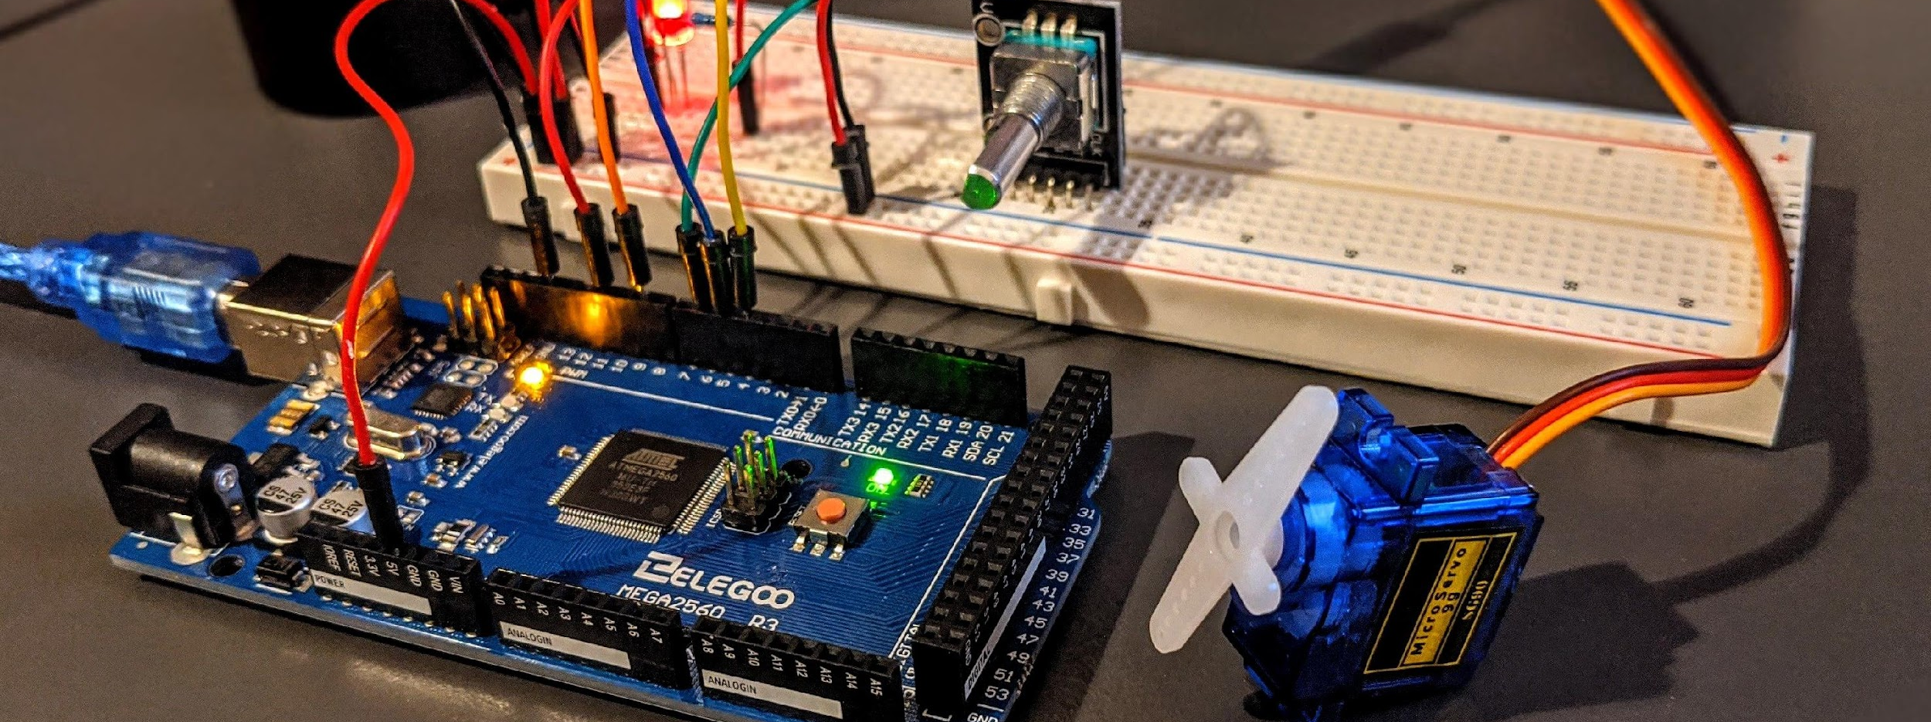




Microcontroller Based Digital Over Voltage Protection System for Industrial Loads
Submitted by – Group P.10
Zulqarnain Bin Ashraf
1606153
Md. Abrar Istiak
1606155
Mortuza Minhaj Chowdhury
1606157
Rafid Umayer Murshed
1606186

Slide 2
Outline
Summary
Background
Methods
Components
Block Diagram
Algorithm
Simulation
PCB layout and 3d rendering
Photo Gallery
Future Outlook
Conclusion

Slide 3
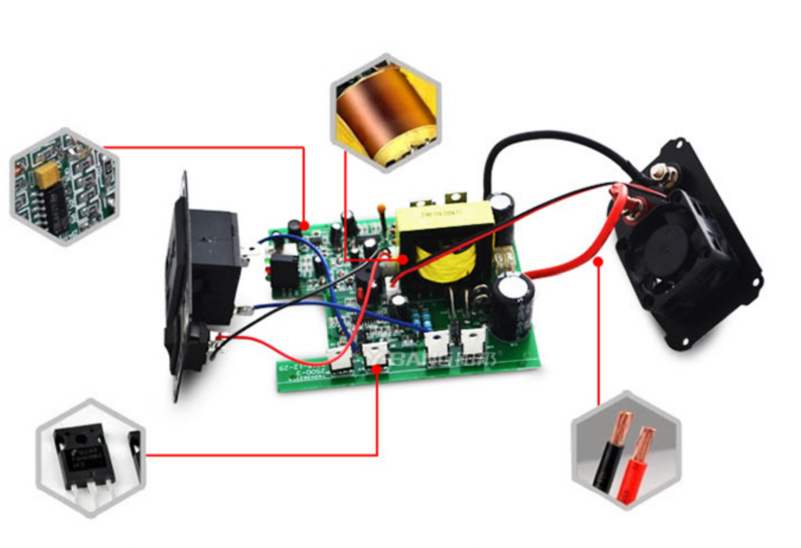
Summary
Overvoltages are all voltages that temporarily surpass the threshold value of the mains voltage.
An overvoltage protection system is developed using ARM cortex microcontroller.
Industrial Loads are protected from sudden voltage surge using the developed system.
A generalized approach is demonstrated which is scalable and efficient.

Slide 4
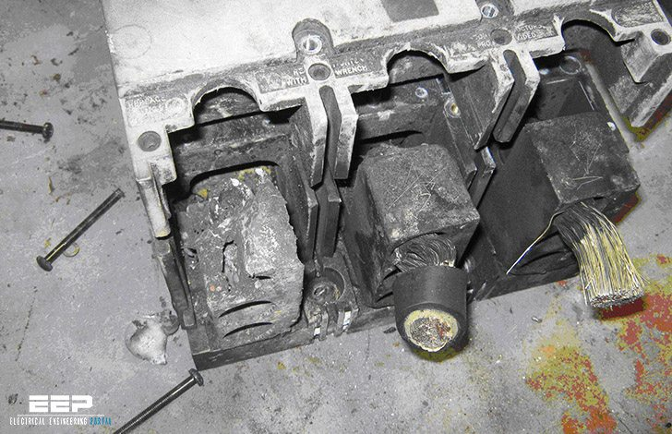
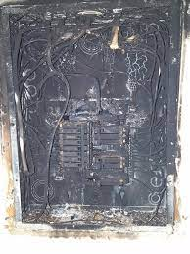

Background
Frequently, industrial equipments are damaged beyond repair due to over-voltage.
Useful lifespan of the equipments decrease due to constant overvoltage.
Extreme cases may result in fire breakout or other deadly hazards.

Slide 5

Methods

Slide 6
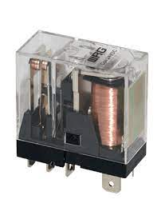
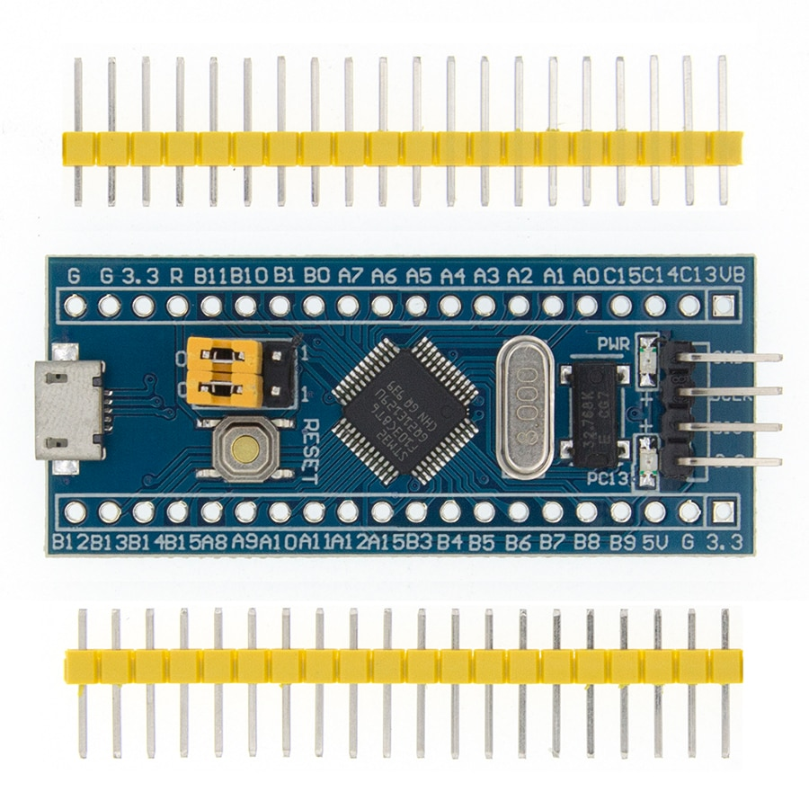
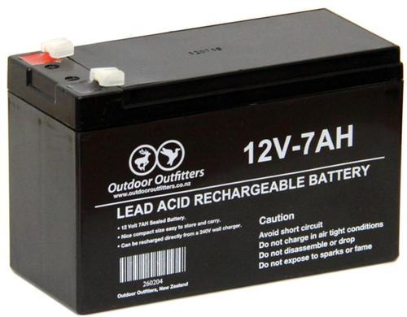
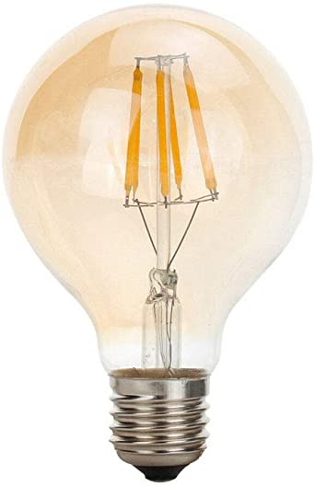
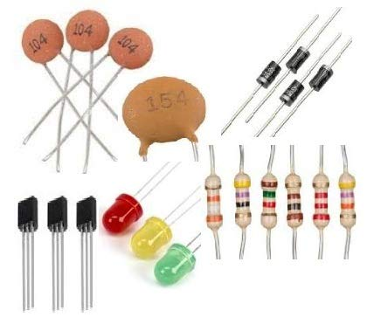
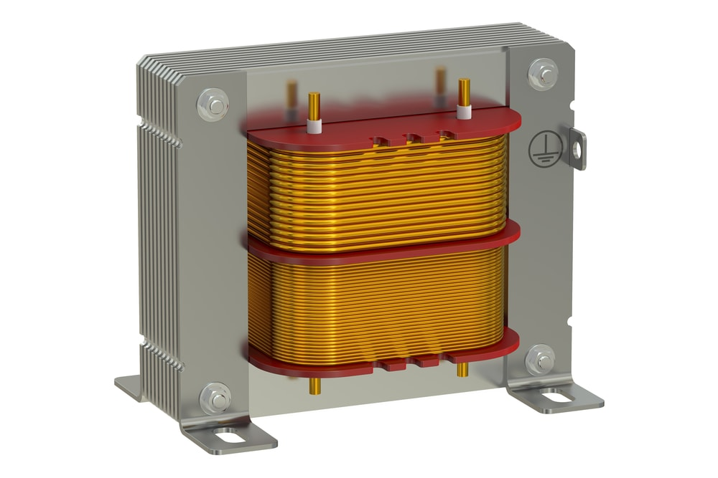
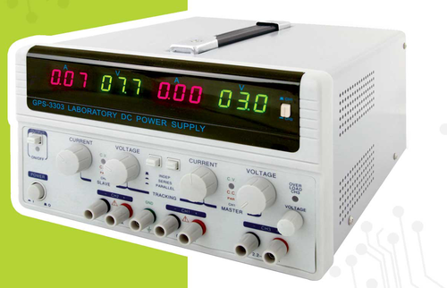
Components
STM32f103c6 (ARM Cortex M3)
Magnetic Relay
12V DC Battery
Capacitors,Resistors,LEDs, Transistors etc.
Light Bulb( Industrial Load)
Transformer
AC Power Supply

Slide 7
Block Diagram
STM32 (ARM Cortex)
Runs a program according to a given algorithm
Relay1
Bulb1
Input AC supply
Step down, rectified dc voltage
Relay2
Bulb2

Slide 8
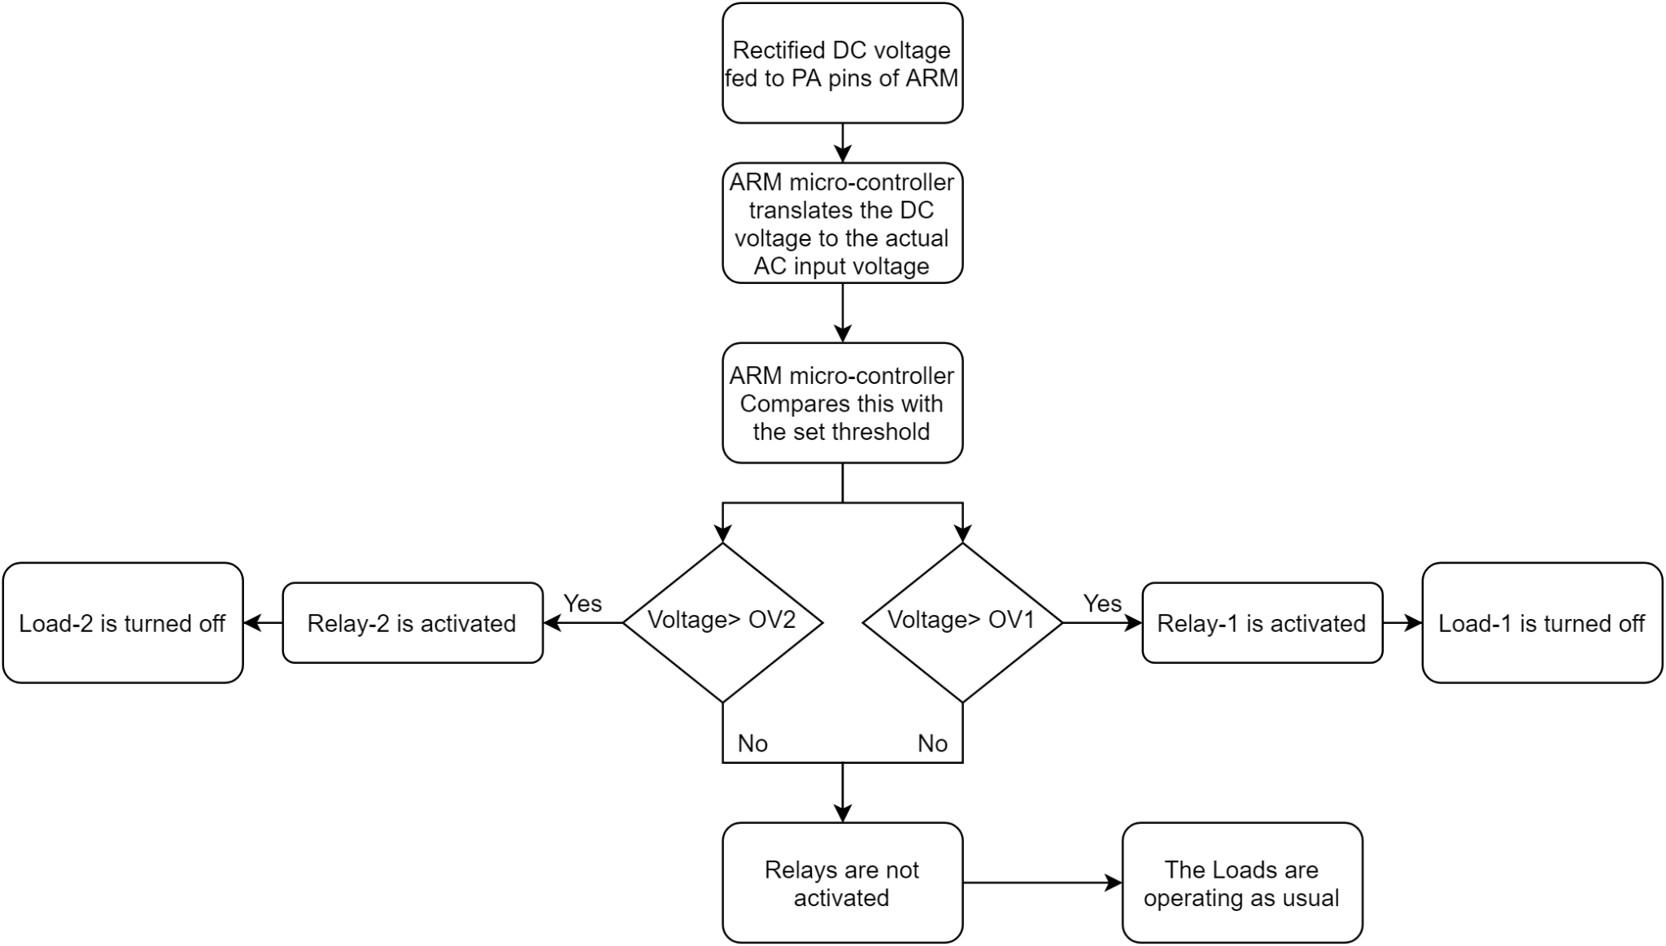
Algorithm (Flowchart)

Slide 9
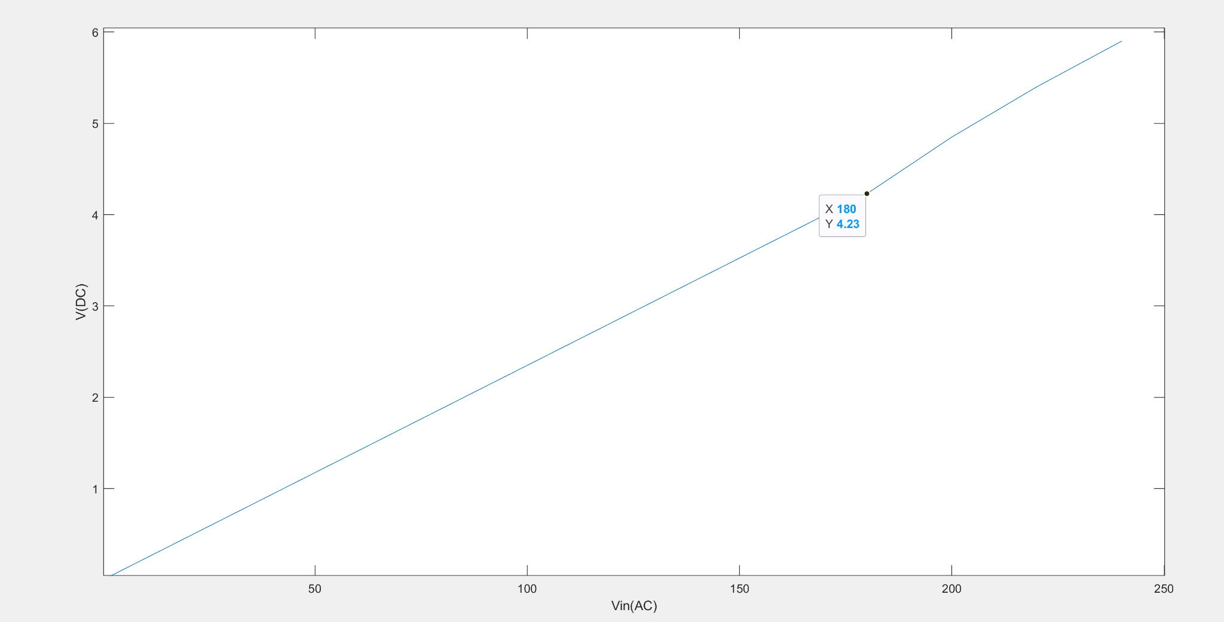
Voltage Reading
We use a 12 bit ADC
Hence, Resolution is 4095/volt
ARM maps 0 to 5V to 0 to 3V
Hence, 3V reads as 3x4095
The DC voltage at analog pin = analog value x 3/(5x4095)
The graph shows how the ac input is transformed to a DC input at the analog pin of ARM.

Slide 10
Simulation
See simulation in full video from 4:13 - 6:24 min
Link: https://web.microsoftstream.com/video/1f505a3d-c1e3-4dee-9447-57fbf539034e

Slide 11
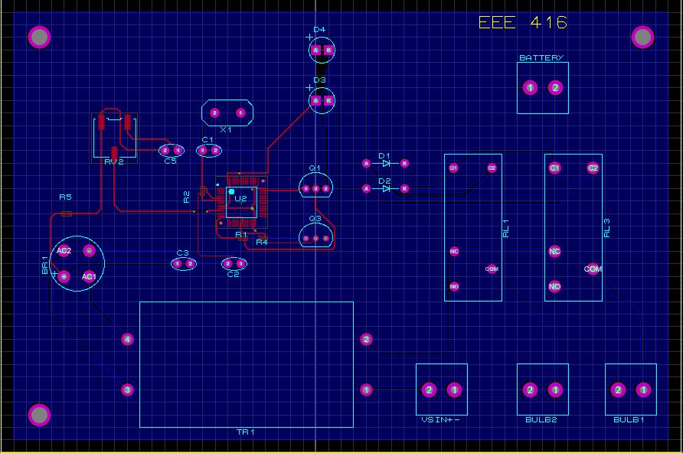
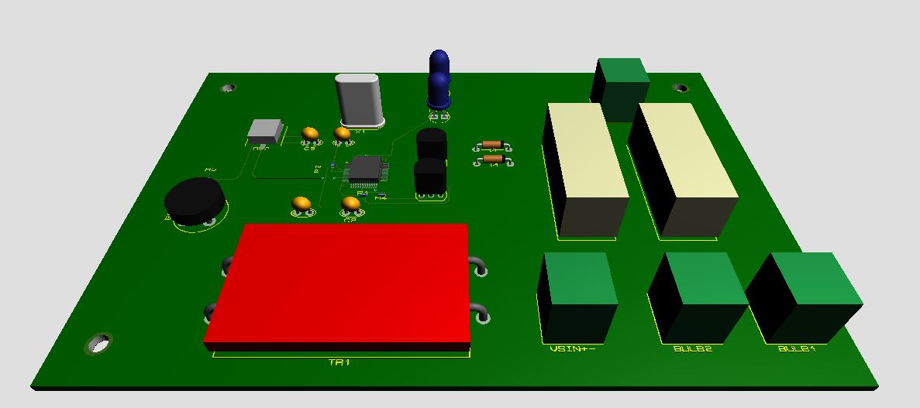
PCB Layout and 3d rendering
PCB Layout
3D Render

Slide 12
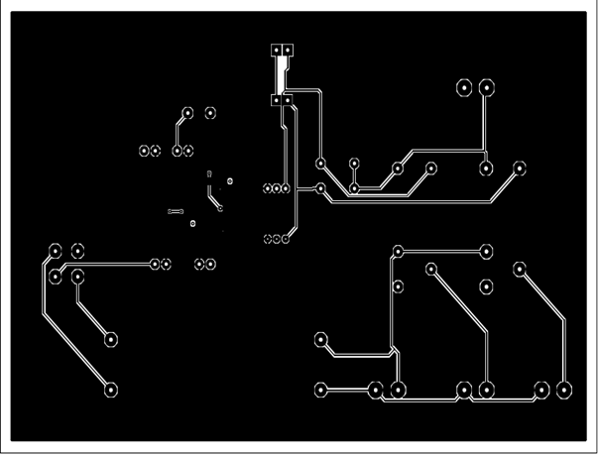
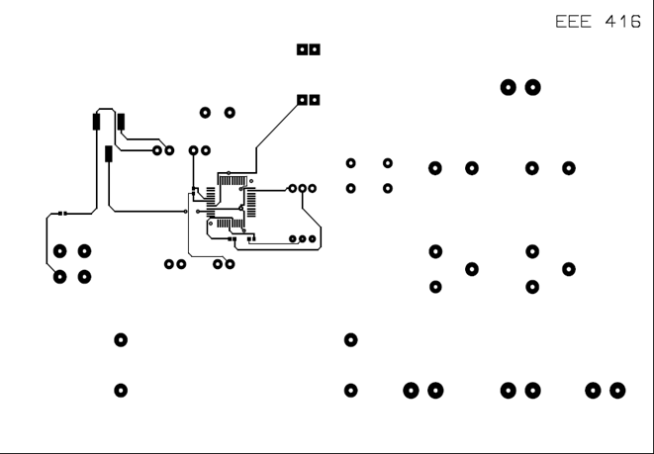
Photo Gallery
Bottom Layer
Top Layer

Slide 13
Future Outlook
Add option for undervoltage detection. Undervoltage also can cause damage to devices thus it will also shut down connection with other devices when experience undervoltage in main supply.
Add more thresholds for multiple rated load and devices.
Incorporate IoT for home/ industry security automation task.
Add short circuit/ overcurrent detection system.

Slide 14
Conclusion
STM32 gives more precision and higher speed of operation rather than other microcontrollers.
Using the idea to our main circuit protection system, we can implement smart circuit protection system.
Vital circuit protection component for home and industrial appliances.
Apart from hardware verification the system showed great success in simulation for the specific task.

Slide 15


Slide 16
Additional Slides

Slide 17
References
STM32 datasheet: https://www.st.com/en/microcontrollers-microprocessors/stm32f103c6.html
Cubeide details: https://www.st.com/en/development-tools/stm32cubeide.html
Adc document: https://stackoverflow.com/questions/41630271/how-to-convert-reading-adc-value-to-float?fbclid=IwAR2bxq5miHmP3fYutbqnkZHJlccdv4gmRBWsFUkh2N2bbTyw_ajumBJeju0

Slide 18
Bill of Materials
Name of Component | Quantity | Price** (BDT)
Capacitor (SMD + Ceramic) | 4 | 12*4 = 48
Resistor (SMD) | 3 | 5*3 = 15
STM32F103C8T6 ARM STM32 | 1 | 1*850 = 850
Darlington transistor (TIP132) | 2 | 2*20 = 40
Diode 1N4007 | 2 | 2*2 = 4
LED | 2 | 2*2 = 4
Bridge Diode 2W10 | 1 | 1*15 = 15
Terminal Connector | 4 | 4*8 = 32
12V Relay | 2 | 2*25 = 50
Variable Resistor Pot (SMD) | 1 | 1*4 = 4
Crystal Oscillator | 1 | 1*10 = 10
Step down transformer | 1 | 1*215 = 215
 |  | Total = 1287 (approx.)
**All prices are collected
from local market

Slide 19
Detailed Methods
Software and Tools:
Proteus 10.1
STM32CubeIDE 1.6.1
Video Link:
https://web.microsoftstream.com/video/1f505a3d-c1e3-4dee-9447-57fbf539034e

Slide 20
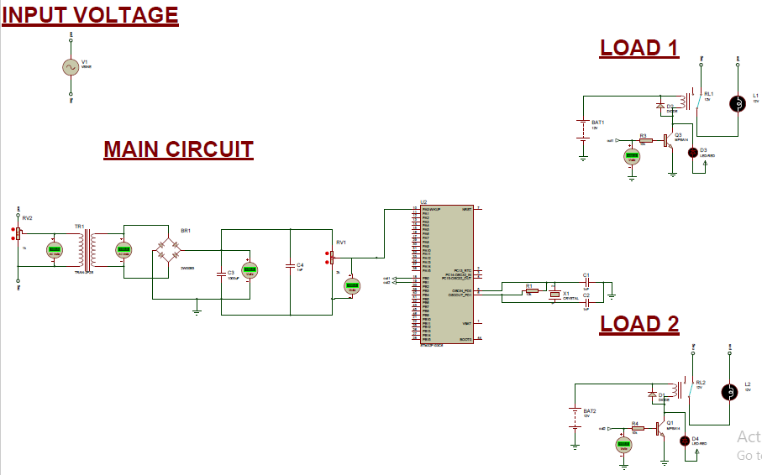
Circuit Diagram

Slide 21
Source Codes
#include "main.h"
ADC_HandleTypeDef hadc1;
UART_HandleTypeDef huart1;
/* Private function prototypes -------------------------------*/
void SystemClock_Config(void);
static void MX_GPIO_Init(void);
static void MX_ADC1_Init(void);
static void MX_USART1_UART_Init(void);
/* Private user code --------------------------------------------*/
int main(void)
{
uint16_t raw;
uint32_t res;
char msg[10];
SystemClock_Config();
/* Initialize all configured peripherals */
MX_GPIO_Init();
MX_ADC1_Init();
MX_USART1_UART_Init();
while (1)
{
//GET ADC VALUE (Get value of DC voltage in analog pin)
HAL_ADC_Start(&hadc1);
HAL_ADC_PollForConversion(&hadc1,HAL_MAX_DELAY);
raw = HAL_ADC_GetValue(&hadc1);
res = (raw*100)/4095; //as 12 bit adc we divide it by 4095
//condition to turn off relay
if(res >= 299) { //299 is observed threshold, relay off
HAL_GPIO_WritePin(GPIOB, GPIO_PIN_0, GPIO_PIN_SET);
HAL_GPIO_WritePin(GPIOB, GPIO_PIN_1, GPIO_PIN_SET);
}

Slide 22
Source Codes
//condition to continue current state
else
{ //turn off, relay on
HAL_GPIO_WritePin(GPIOB, GPIO_PIN_0, GPIO_PIN_RESET);
HAL_GPIO_WritePin(GPIOB, GPIO_PIN_1, GPIO_PIN_RESET);
}
//convert to string and print
sprintf(msg,"%u pourcent \r\n",res);
HAL_UART_Transmit(&huart1,(uint8_t*)msg,strlen(msg),HAL_MAX_DELAY);
HAL_Delay(10);
}
}
void SystemClock_Config(void)
{
RCC_OscInitTypeDef RCC_OscInitStruct = {0};
RCC_ClkInitTypeDef RCC_ClkInitStruct = {0};
RCC_PeriphCLKInitTypeDef PeriphClkInit = {0};
RCC_OscInitStruct.OscillatorType = RCC_OSCILLATORTYPE_HSI;
RCC_OscInitStruct.HSIState = RCC_HSI_ON;
RCC_OscInitStruct.HSICalibrationValue = RCC_HSICALIBRATION_
DEFAULT;
RCC_OscInitStruct.PLL.PLLState = RCC_PLL_NONE;
if (HAL_RCC_OscConfig(&RCC_OscInitStruct) != HAL_OK)
{
Error_Handler();
}
RCC_ClkInitStruct.ClockType = RCC_CLOCKTYPE_HCLK|RCC_
CLOCKTYPE_SYSCLK|RCC_CLOCKTYPE_PCLK1|RCC_CLOCKTYPE_
PCLK2;
RCC_ClkInitStruct.SYSCLKSource = RCC_SYSCLKSOURCE_HSI;
RCC_ClkInitStruct.AHBCLKDivider = RCC_SYSCLK_DIV1;

Slide 23
Source Codes
RCC_ClkInitStruct.APB1CLKDivider = RCC_HCLK_DIV1;
RCC_ClkInitStruct.APB2CLKDivider = RCC_HCLK_DIV1;
if (HAL_RCC_ClockConfig(&RCC_ClkInitStruct, FLASH_LATENCY_0) != HAL_OK)
{
Error_Handler();
}
PeriphClkInit.PeriphClockSelection = RCC_PERIPHCLK_ADC;
PeriphClkInit.AdcClockSelection = RCC_ADCPCLK2_DIV2;
if (HAL_RCCEx_PeriphCLKConfig(&PeriphClkInit) != HAL_OK)
{
Error_Handler();
}
}
static void MX_ADC1_Init(void)
{
ADC_ChannelConfTypeDef sConfig = {0};
/** Common config*/
hadc1.Instance = ADC1;
hadc1.Init.ScanConvMode = ADC_SCAN_DISABLE;
hadc1.Init.ContinuousConvMode = DISABLE;
hadc1.Init.DiscontinuousConvMode = DISABLE;
hadc1.Init.ExternalTrigConv = ADC_SOFTWARE_START;
hadc1.Init.DataAlign = ADC_DATAALIGN_RIGHT;
hadc1.Init.NbrOfConversion = 1;
if (HAL_ADC_Init(&hadc1) != HAL_OK)
{
Error_Handler();
}
sConfig.Channel = ADC_CHANNEL_0;
sConfig.Rank = ADC_REGULAR_RANK_1;
sConfig.SamplingTime = ADC_SAMPLETIME_1CYCLE_5;
if (HAL_ADC_ConfigChannel(&hadc1, &sConfig) != HAL_OK)
{
Error_Handler();
}

Slide 24
Source Codes
static void MX_USART1_UART_Init(void)
{
huart1.Instance = USART1;
huart1.Init.BaudRate = 115200;
huart1.Init.WordLength = UART_WORDLENGTH_8B;
huart1.Init.StopBits = UART_STOPBITS_1;
huart1.Init.Parity = UART_PARITY_NONE;
huart1.Init.Mode = UART_MODE_TX_RX;
huart1.Init.HwFlowCtl = UART_HWCONTROL_NONE;
huart1.Init.OverSampling = UART_OVERSAMPLING_16;
if (HAL_UART_Init(&huart1) != HAL_OK)
{
Error_Handler();
}
}
static void MX_GPIO_Init(void)
{
GPIO_InitTypeDef GPIO_InitStruct = {0};
__HAL_RCC_GPIOD_CLK_ENABLE();
__HAL_RCC_GPIOA_CLK_ENABLE();
__HAL_RCC_GPIOB_CLK_ENABLE();
/*Configure GPIO pin Output Level */
HAL_GPIO_WritePin(GPIOB, GPIO_PIN_0|GPIO_PIN_1,
GPIO_PIN_RESET);
/*Configure GPIO pins : PB0 PB1 */
GPIO_InitStruct.Pin = GPIO_PIN_0|GPIO_PIN_1;
GPIO_InitStruct.Mode = GPIO_MODE_OUTPUT_PP;
GPIO_InitStruct.Pull = GPIO_NOPULL;
GPIO_InitStruct.Speed = GPIO_SPEED_FREQ_LOW;
HAL_GPIO_Init(GPIOB, &GPIO_InitStruct);
}
void Error_Handler(void)
{
disable_irq();
void assert_failed(uint8_t *file, uint32_t line)
{
}
#endif /* USE_FULL_ASSERT */

Slide 25
Difficulties
In driving a load using output pin of STM 32 we faced scarcity of current supply. So we overcame that by using darlington pair transistor which is a two staged transistor having a high gain.
Changing of input voltage continuously was a constraint in proteus. Thus, we used a potentiometer to tweak the desired input voltage.
Directly feeding high voltage to the microcontroller wasn’t a good idea so we first step down it to around 12V and then rectify it to turn into dc voltage. Finally rectified dc voltage is fed to the microcontroller to avoid any kind of hazardous situation.
In PCB designing, traces for power and signal line should be maintained appropriately otherwise over current can cause damage to circuit.

